Slide 1
SQL
for students
Lecture 1
Notes:
Greetings including:
who am I – Valentin Morev, will read a set of SQL lectures
How are you – feelings about training, what lectures were read, what j2ee task is in progress

Slide 2
Data storage types
File system based
Property file
XML file
Other well known files
Special software
database
Other
Serialized data
Custom formats
Notes:
When to use each of them:
File system based – easy to change by user, standalone software

Slide 3
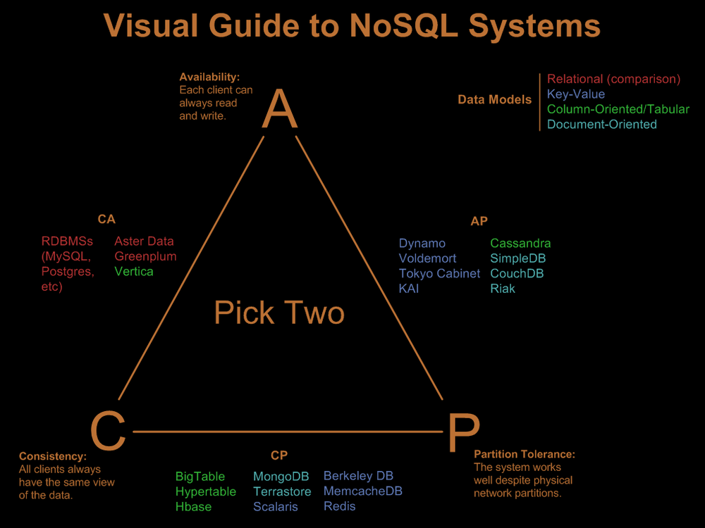
Types of databases
Notes:
Special software – oriented on performance, transactions, data retrieval language out of the box
Key-value – high performance, huge partitioned storage
Column/tabular – same as key-value but allow multiply columns
Document oriented – same as above but each record is an object
Relational – transactions, security, SQL language

Slide 4
Relational databases
MS SQL
Oracle
MySQL
PostgreSQL
Notes:
All these DBs implement SQL 92 standard but other syntax (user management, schema management) can vary
MSSQL used when Windows server or .NET technologies are used
Oracle is for Linux and Java
MySQL is currently a part of Oracle. There is a free version still. Internet is mostly using 4.0 version which has very limited functions, latest version is quite advanced
PostgreSQL is another Linux oriented database

Slide 5
DML vs DDL
Data Manipulation Language
Data Definition Language
Select
Insert
Update
Delete
Call
Create table (proc, index …)
Alter table
Drop table (proc, index …)
Truncate table
Rename
Notes:
Common approach is to
1. have DDL defined before application start
2. Application will call DML only

Slide 6
Transaction Control (TCL)
Commit
Rollback
Savepoint
DML only! Means…you can’t rollback table creation
Notes:
Calling DML without commit will lead to changes loss
DDL is not handled by transactions. Each operation is auto committed.

Slide 7
Database objects
Users (schemas)
Tables
Views
Constraints (PK, FK, other)
Indexes
Triggers
Procedures and packages
Functions
Temporary tables
Notes:
Users are to have more then one database on the same server. Other reason is a security
Tables are to store data
Views are to represent stored data based on some logic
Constraints are to add restrictions to the data in tables
Indexes are to speed up filtering on specific columns
Triggers are to handle update, insert or delete events before or after they took place
Procedures are to isolate piece of code, packages are to isolate private methods and variables
Functions are mostly to be used inside SQL statements. You can write your version of SUM, COUNT
Temporary tables are to store session specific data

Slide 8
Insert statement
insert into TBL (ID, NAME) values (1, ‘test’)
insert into TBL values (1, (select name from TBL2 where id=1))
insert into TBL (select id, name from TBL2)
insert into TBL (ID, NAME) (select id, name from TBL2)
Notes:
When to use each variant

Slide 9
Update statement
update TBL set NAME=‘test’
update TBL set NAME=‘test’, DESC=‘test’
update TBL set NAME=‘test’ where ID=1
update TBL set (NAME, DESC) = (select NAME, DESC from TBL2 where TBL.ID=TBL2.ID)

Slide 10
Delete statement
delete from TBL
delete from TBL where ID=1

Slide 11
Select statement
select * from employees
select employee_id, first_name||' '||last_name from employees
select distinct salary from employees
select distinct salary from employees where department_id=80
select * from employees order by first_name
select first_name, salary*12 as sal_year from employees
select 2+3 as sum from dual
Notes:
Specific of *
Specific of distinct and (partially) order

Slide 12
Where clause
Boolean conditions ( <, >, =, >=, <=) select * from employees where salary > 10000
Logical conditions (not, and, or) select * from employees where salary > 10000 and department_id=80
Is null select * from employees where manager_id is null
Like select * from employees where first_name like '%nn%'
IN select * from employees where salary in (6000, 10000) and employee_id not in (select employee_id from job_history)
Exists select * from employees e where exists (select employee_id from job_history jh where jh.employee_id=e.employee_id)
All / any select * from employees where salary >= all (select salary from employees)

Slide 13
Using Join and inner select
Inner Join
select e.first_name||' '||e.last_name emp, m.first_name||' '||m.last_name man
from employees e
join employees m on m.employee_id=e.manager_id
left join
select e.first_name||' '||e.last_name emp, m.first_name||' '||m.last_name man
from employees e
left join employees m on m.employee_id=e.manager_id
where m.employee_id is null
Inner select
select e.first_name||' '||e.last_name emp, m.first_name||' '||m.last_name man
from employees e, (select * from employees) m
where m.employee_id=e.manager_id
See wikipedia.org/wiki/Join_(SQL)
Notes:
Q: who knows how to solve this task in correct way

Slide 14
Using Union (all)
Union and Union all
select e.first_name||' '||e.last_name emp from employees e where e.salary>10000
union all
select e.first_name||' '||e.last_name emp from employees e where e.manager_id=100

Slide 15
Aggregation in select
Group select count(0), manager_id from employees group by manager_id;
Having select count(0), manager_id from employees group by manager_id having manager_id>200;
Aggregation functions select sum(salary), manager_id from employees group by manager_id;

Slide 16
Home task
Install database
Install database view software
Connect to database using this software
Make SQL script to
Add all existing countries (~190)
Add 3 departments to each country
Add 190k “real” users into employees table
Each department should have about 1k users
Each department should have users of different jobs
Describe how to decrease amount of monkey job

Slide 17
Materials
github.com/vmorev/SQL_lectures
wikipedia.org/wiki/SQL-92
wikipedia.org/wiki/Join_(SQL)

